Slide 1
Scalable Multi-Period Optimal Power Flow for Active Power Distribution Systems or simply, Scalable MP-OPF in ADS
Aryan Ritwajeet Jha
Graduate Research Assistant
Washington State University
Notes:
Remember to hit the reset button to make sure all the page elements react properly.
There are 20 different layouts that you can choose from.

Slide 2
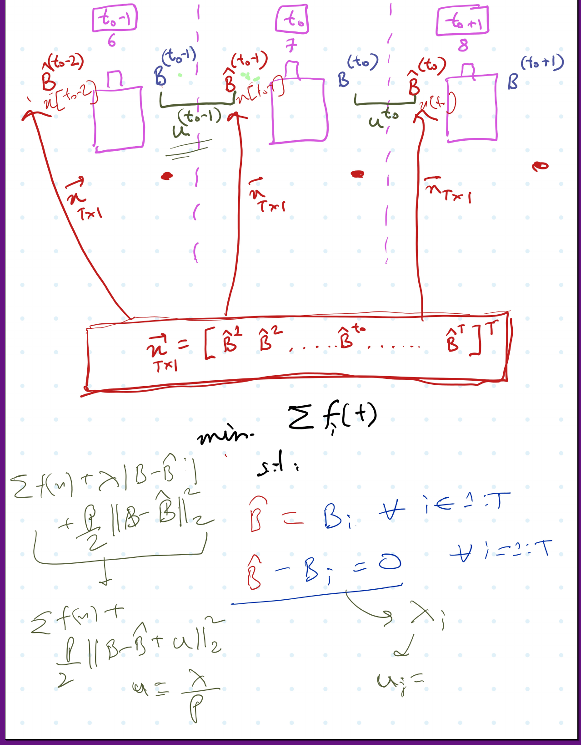
Consensus ADMM formulation for MPOPF
Description

Slide 3
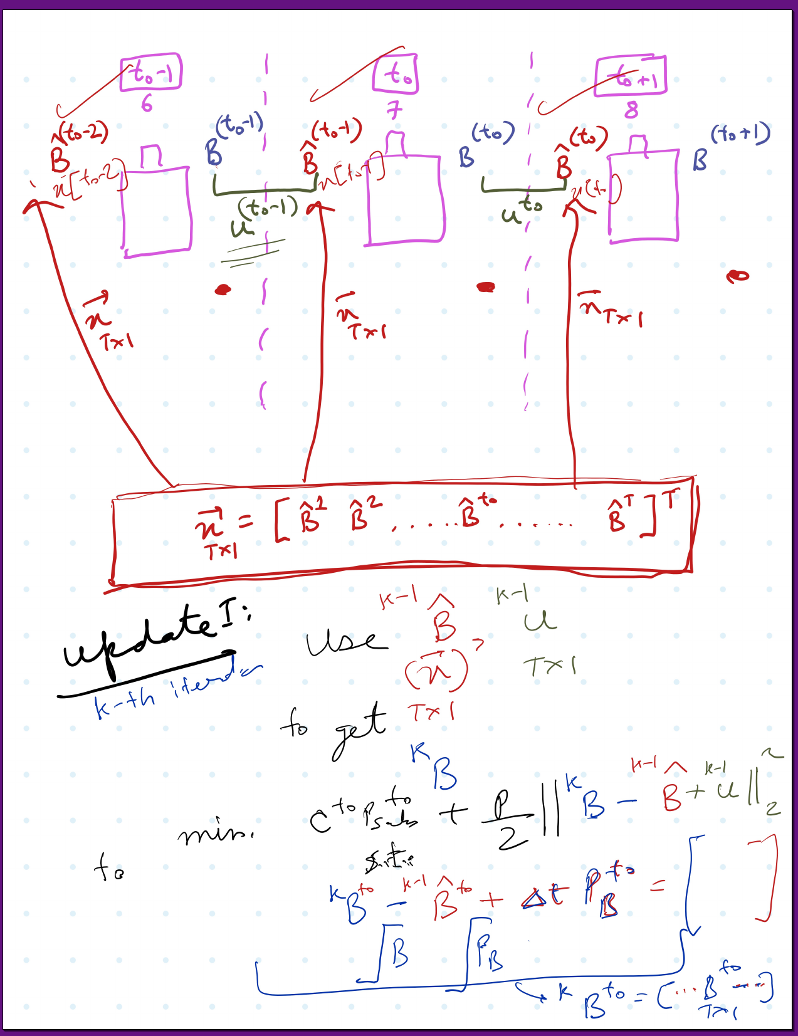
Consensus ADMM formulation for MPOPF
Description

Slide 4
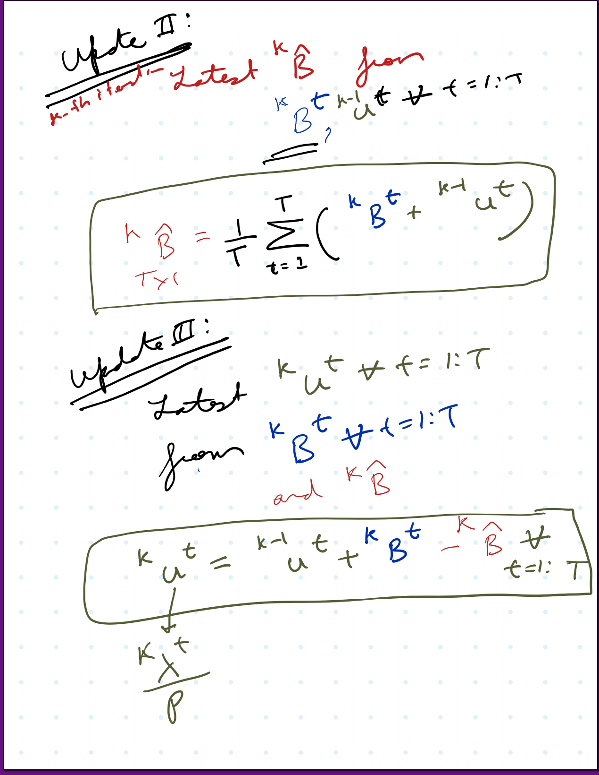
Consensus ADMM formulation for MPOPF
Description

Slide 5

Latest Slides End Here. Previous Slides Follow.

Slide 6
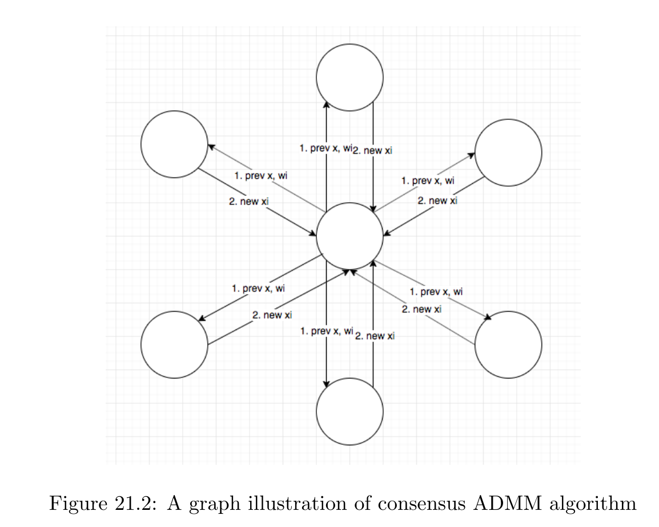
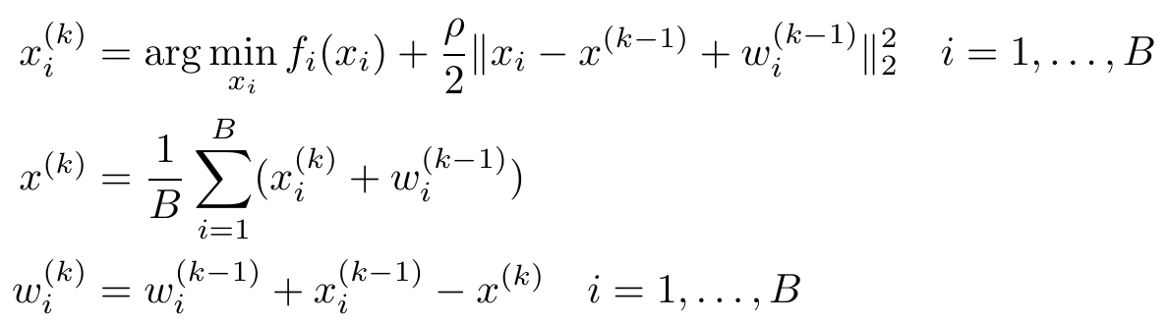
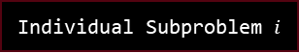
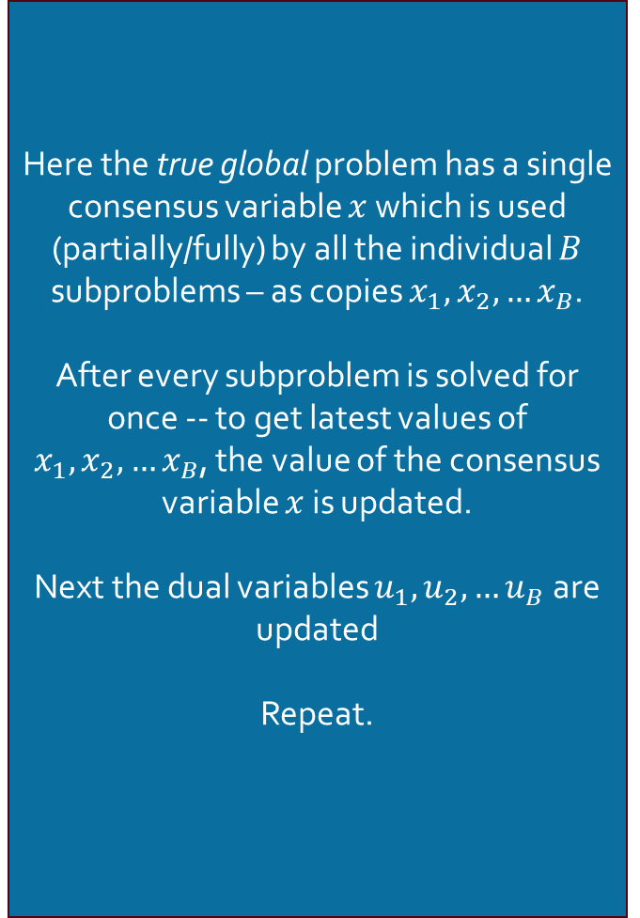
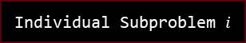
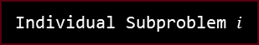

Consensus ADMM formulation
Graph Illustration
Here the true global problem has a single consensus variable $x$ which is used (partially/fully) by all the individual $B$ subproblems – as copies $x_{1},x_{2},…x_{B}$.
After every subproblem is solved for once -- to get latest values of $x_{1},x_{2},…x_{B}$, the value of the consensus variable $x$ is updated.
Next the dual variables $u_{1},u_{2},…u_{B}$ are updated
Repeat.
Individual Subproblem $i$
Individual Subproblem $i$
Individual Subproblem $i$
Global Problem
Individual Subproblem $i$
Individual Subproblem $i$
Individual Subproblem $i$
Source: [ADMM notes CMU]

Slide 7
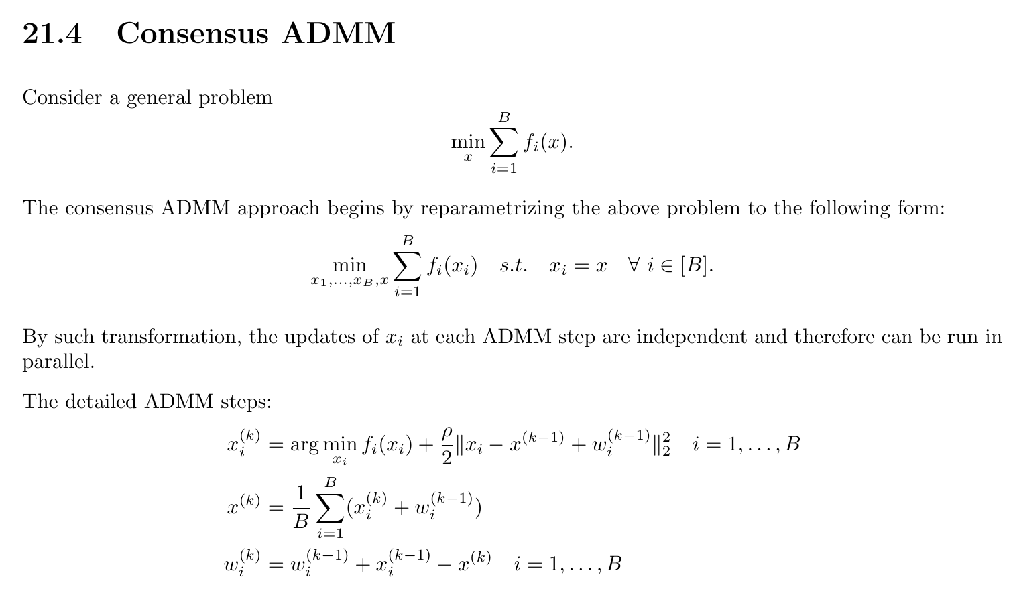
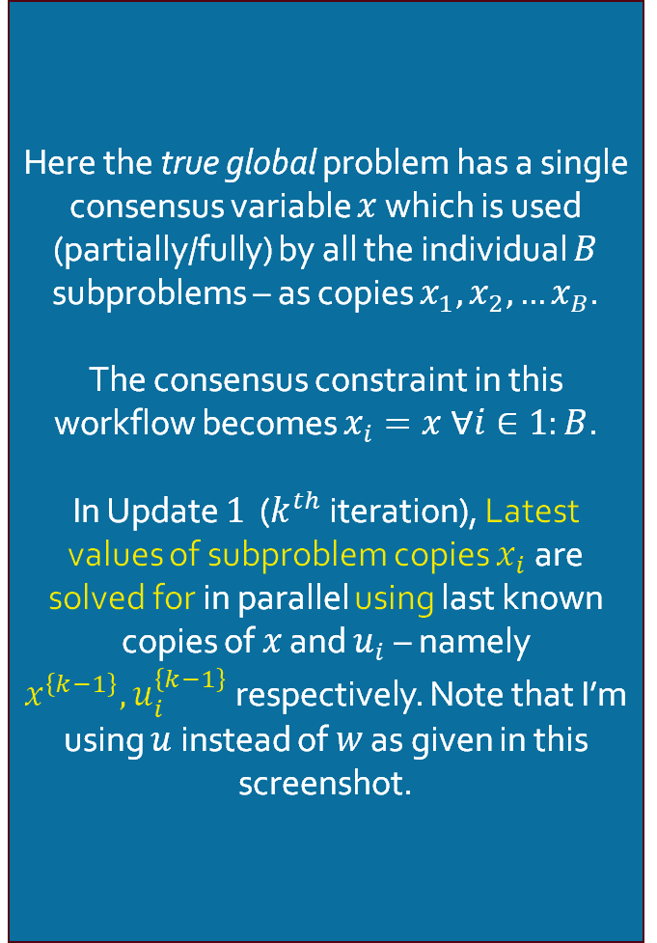

Consensus ADMM formulation
Update $1$: Solve for $x_{i}^{k} ∀i∈1:B$
Here the true global problem has a single consensus variable $x$ which is used (partially/fully) by all the individual $B$ subproblems – as copies $x_{1},x_{2},…x_{B}$.
The consensus constraint in this workflow becomes $x_{i}=x ∀i∈1:B$.
In Update $1$ ($k^{th}$ iteration), Latest values of subproblem copies $x_{i}$ are solved for in parallel using last known copies of $x$ and $u_{i}$ – namely $x^{\left\{k−1\right\}}, u_{i}^{\left\{k−1\right\}}$ respectively. Note that I’m using $u$ instead of $w$ as given in this screenshot.
Note: This is like a one-sided ADMM formluation
Source: [ADMM notes CMU]

Slide 8
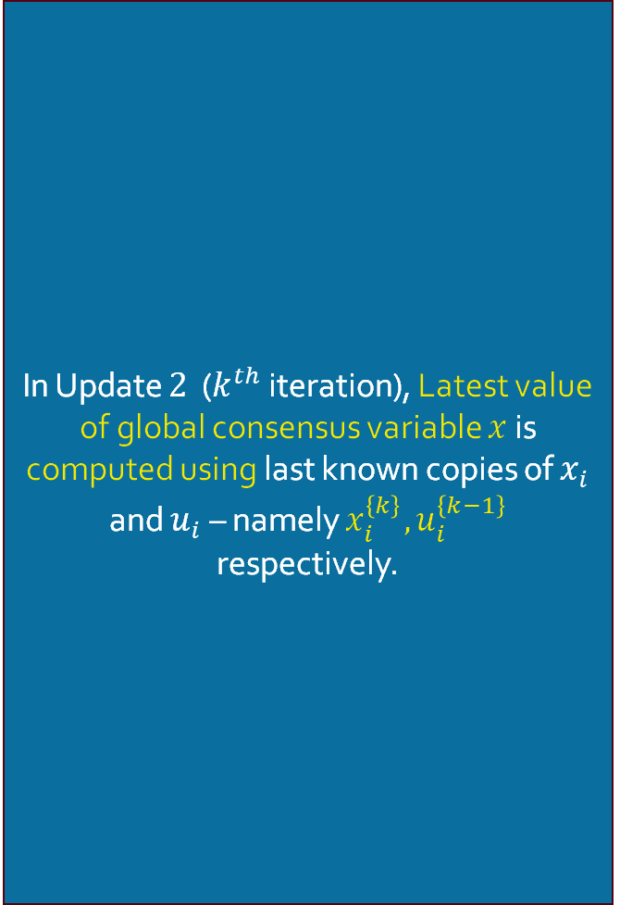

Consensus ADMM formulation
Update $2$: Solve for $x^{k}$
In Update $2$ ($k^{th}$ iteration), Latest value of global consensus variable $x$ is computed using last known copies of $x_{i}$ and $u_{i}$ – namely $x_{i}^{\left\{k\right\}}, u_{i}^{\left\{k−1\right\}}$ respectively.

Slide 9
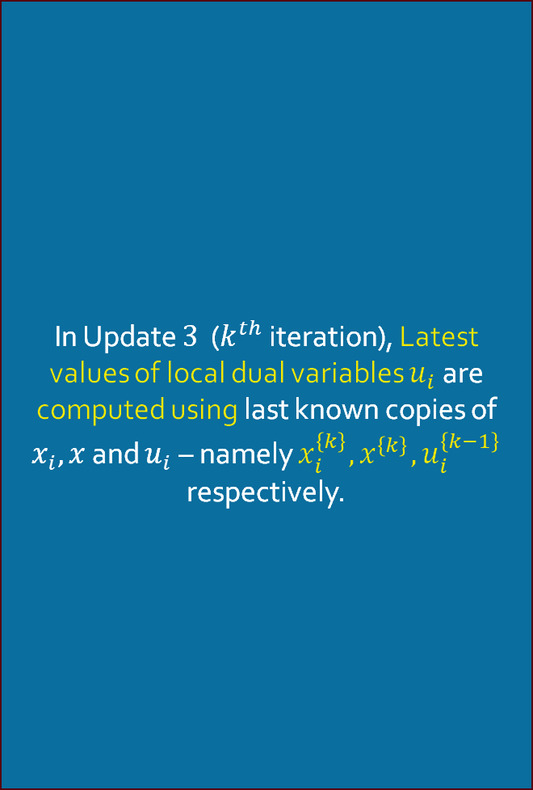

Consensus ADMM formulation
Update $3$: Solve for $u_{i}^{k} ∀ i∈1:B$
In Update $3$ ($k^{th}$ iteration), Latest values of local dual variables $u_{i}$ are computed using last known copies of $x_{i}, x$ and $u_{i}$ – namely $x_{i}^{\left\{k\right\}}, x^{\left\{k\right\}},u_{i}^{\left\{k−1\right\}}$ respectively.

Slide 10
Consensus ADMM formulation
Graph Illustration
Individual Subproblem $i$
Individual Subproblem $i$
Individual Subproblem $i$
Global Problem
Individual Subproblem $i$
Individual Subproblem $i$
Individual Subproblem $i$

Slide 11
Consensus ADMM formulation for MPOPF
Description

Slide 12
Consensus ADMM formulation for MPOPF
Description

Slide 13
Consensus ADMM formulation for MPOPF
Description

Slide 14
References
[ADMM notes CMU] Index of /~ryantibs/convexopt/scribes. (2025, September 01). Retrieved from https://www.stat.cmu.edu/~ryantibs/convexopt/scribes

Slide 15
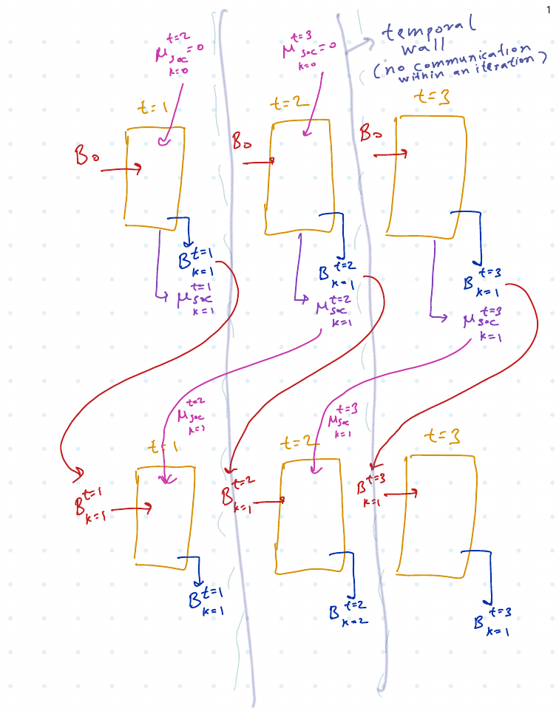

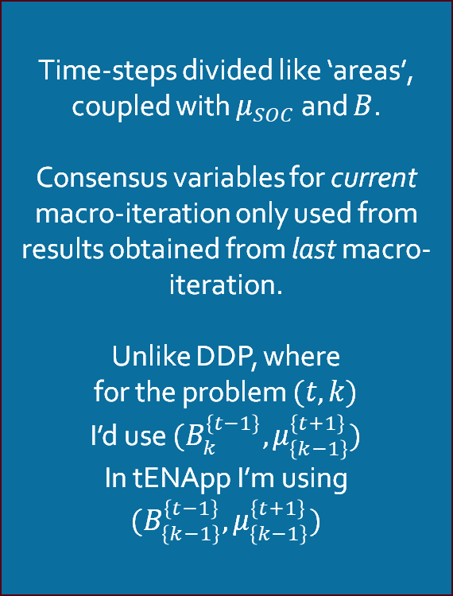
tENApp Algorithm Terminal SOC Constraint Relaxed
$$tENApp$$
Time-steps divided like ‘areas’, coupled with $μ_{SOC}$ and $B$.
Consensus variables for current macro-iteration only used from results obtained from last macro-iteration.
Unlike DDP, where
for the problem $(t, k)$
I’d use $(B_{k}^{\left\{t−1\right\}}, μ_{\left\{k−1\right\}}^{\left\{t+1\right\}})$
In tENApp I’m using $(B_{\left\{k−1\right\}}^{\left\{t−1\right\}}, μ_{\left\{k−1\right\}}^{\left\{t+1\right\}})$

Slide 16
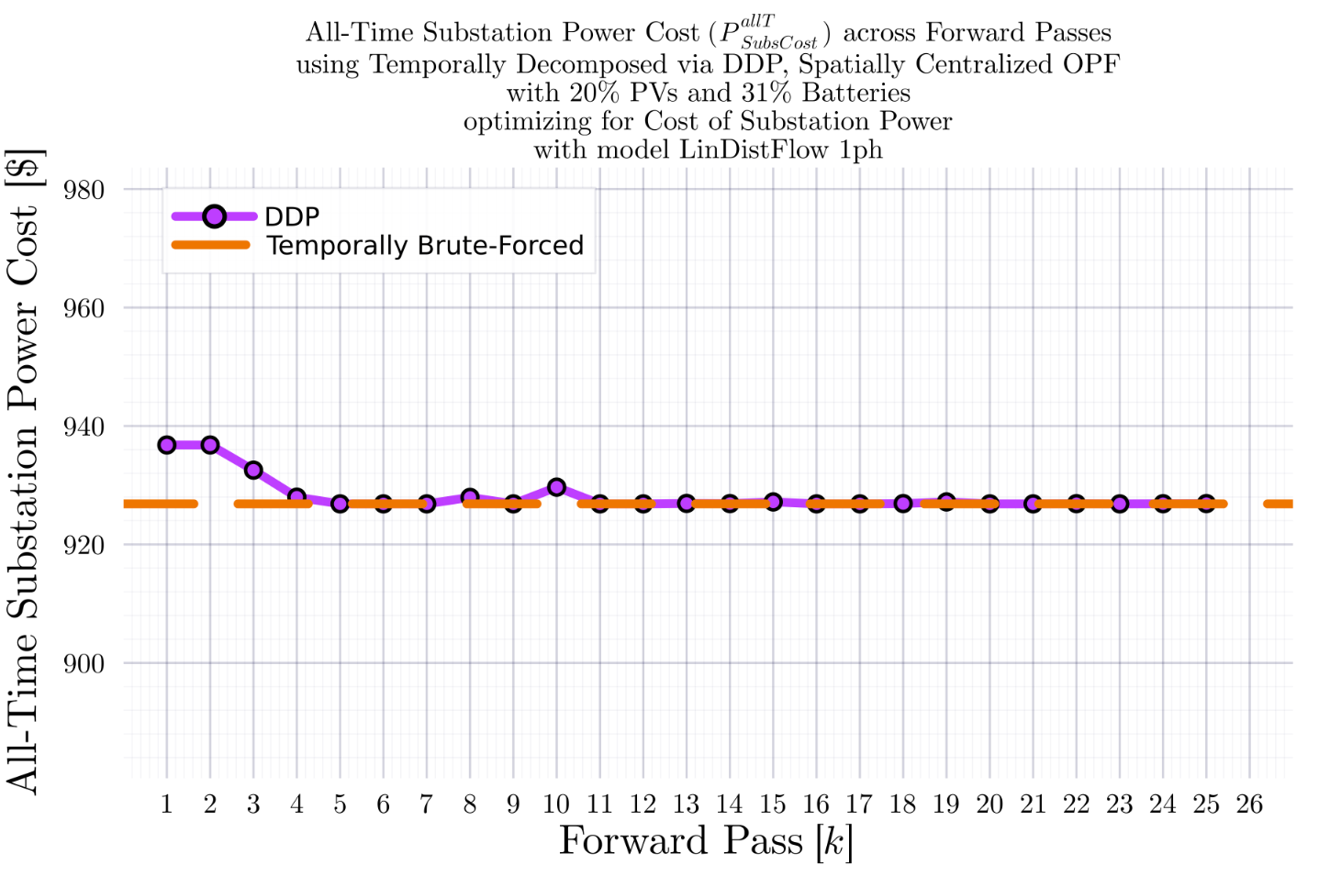
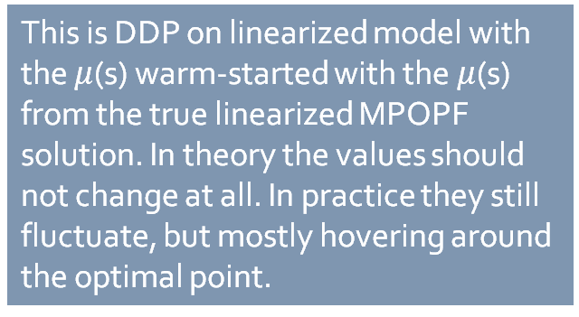
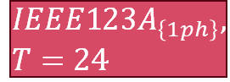
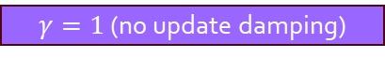


DDP Trajectory vs #Forward Passes $[k]$: LinDistFlow Model Terminal SOC Constraint Relaxed
$$IEEE123A_{\left\{1ph\right\}}, T=24$$
BruteForced (BF)
$$DDP$$
This is DDP on linearized model with the $μ$(s) warm-started with the $μ$(s) from the true linearized MPOPF solution. In theory the values should not change at all. In practice they still fluctuate, but mostly hovering around the optimal point.
$γ=1$ (no update damping)
$$k_{Max}=25$$

Slide 17
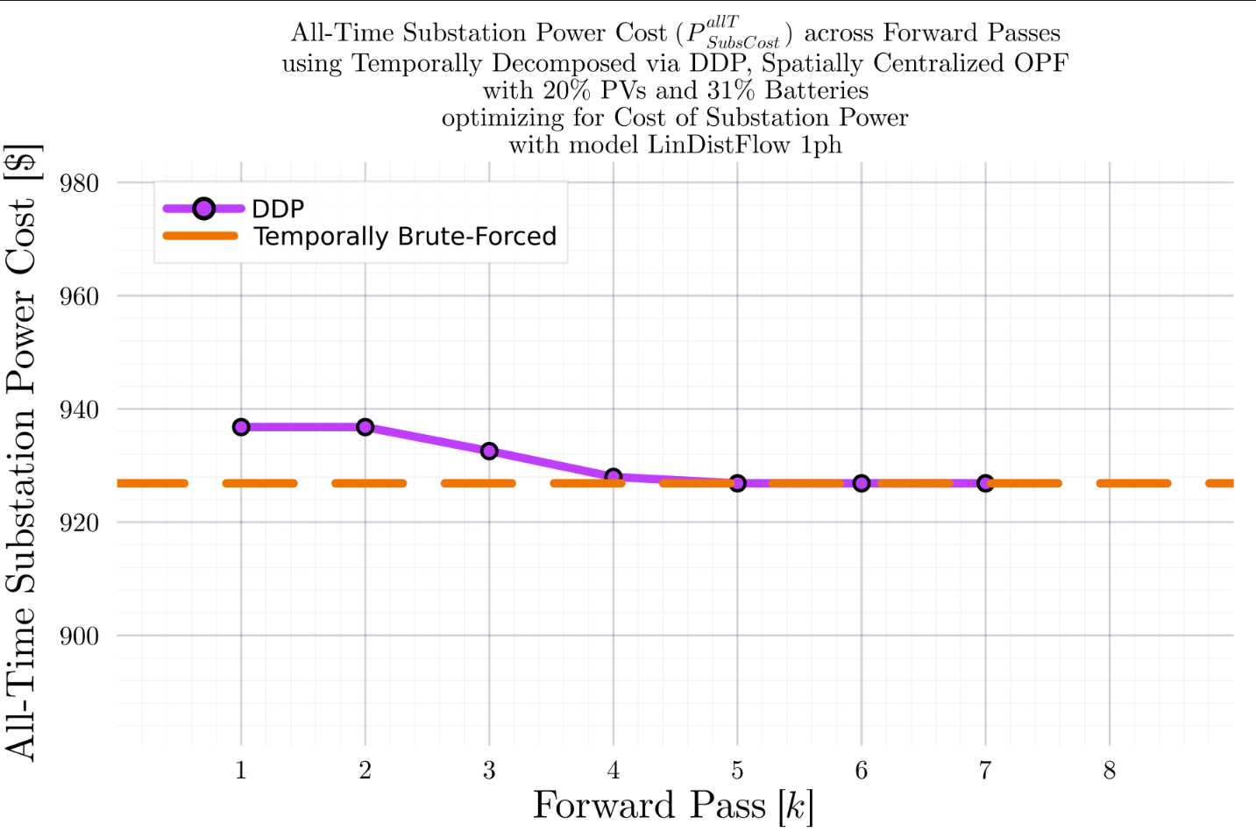
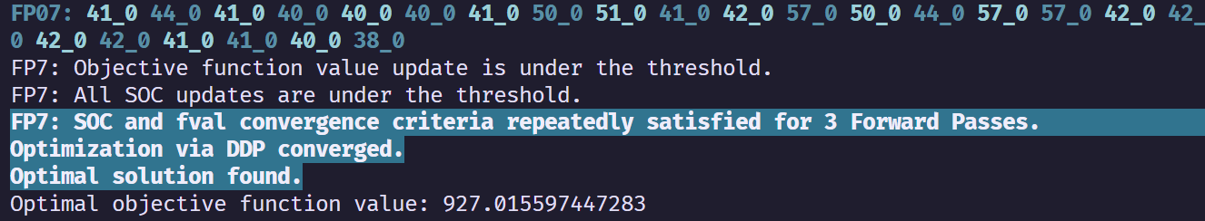
DDP Trajectory vs #Forward Passes $[k]$: LinDistFlow Model Terminal SOC Constraint Relaxed
$$IEEE123A_{\left\{1ph\right\}}, T=24$$
BruteForced (BF)
$$DDP$$
With some ‘convergence-catching’ heuristic in place (declare convergence if SOC and fval are not changing for 3 Forward Passes), DDP converges.
$γ=1$ (no update damping)
$$k_{Max}=25$$

Slide 18
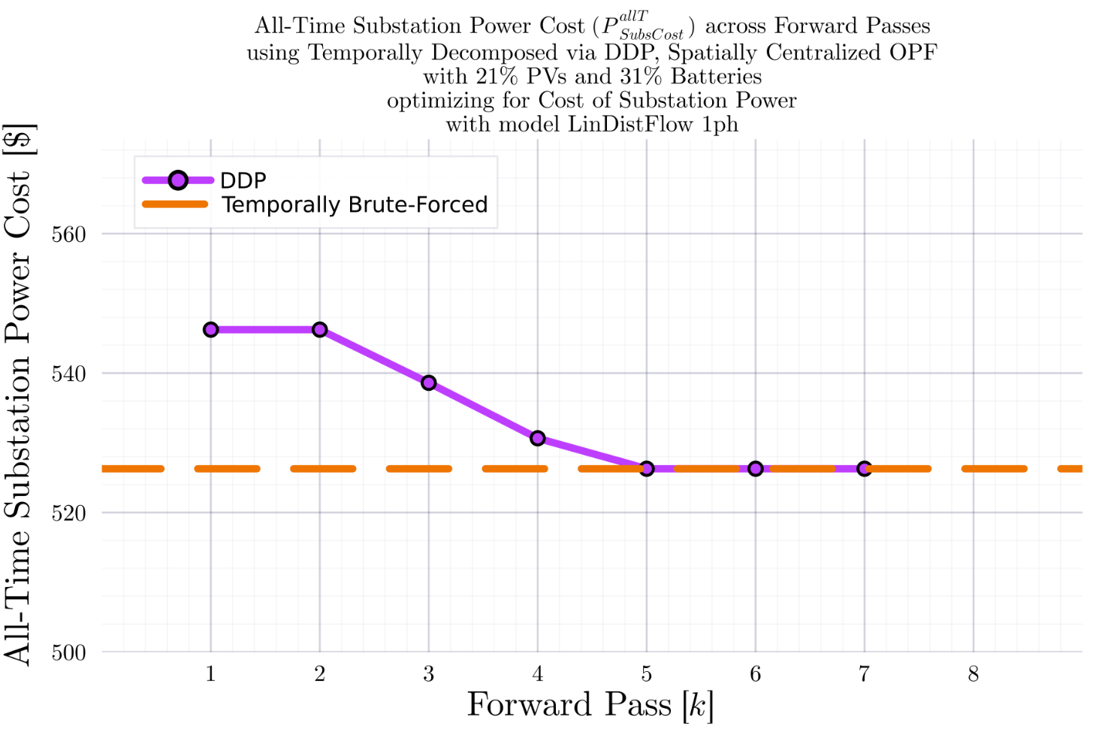
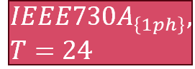
DDP Trajectory vs #Forward Passes $[k]$: LinDistFlow Model Terminal SOC Constraint Relaxed
$$IEEE730A_{\left\{1ph\right\}}, T=24$$
BruteForced (BF)
$$DDP$$
With some ‘convergence-catching’ heuristic in place (declare convergence if SOC and fval are not changing for 3 Forward Passes), DDP converges.
$γ=1$ (no update damping)
$$k_{Max}=25$$

Slide 19
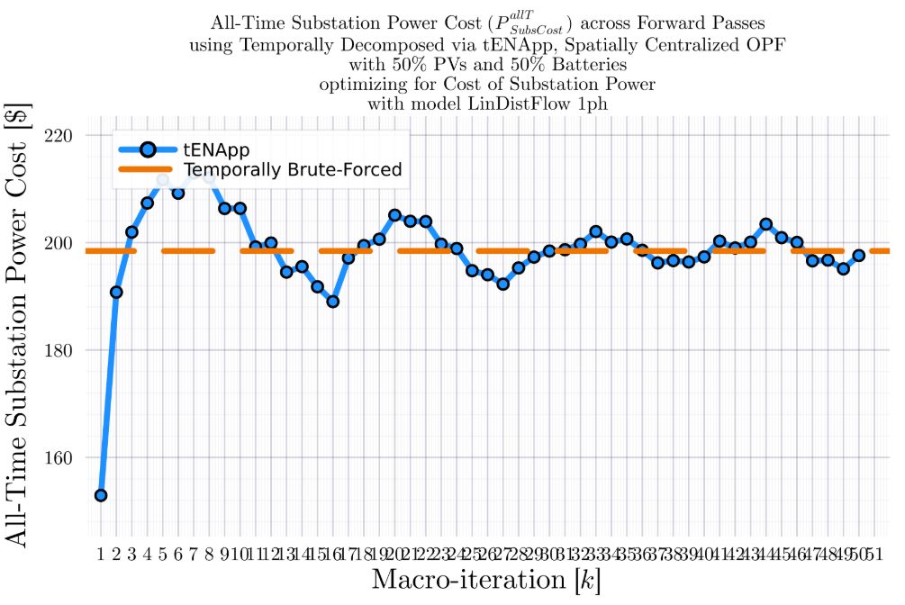
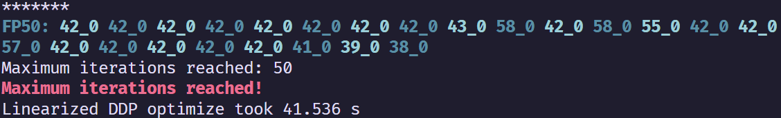
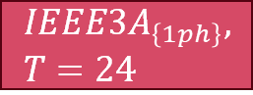



tENApp Trajectory vs #Forward Passes $[k]$: LinDistFlow Model Terminal SOC Constraint Relaxed
$$IEEE3A_{\left\{1ph\right\}}, T=24$$
BruteForced (BF)
$$tENApp$$
$γ=1$ (no update damping)
$$k_{Max}=50$$
$$α=4.00$$

Slide 20
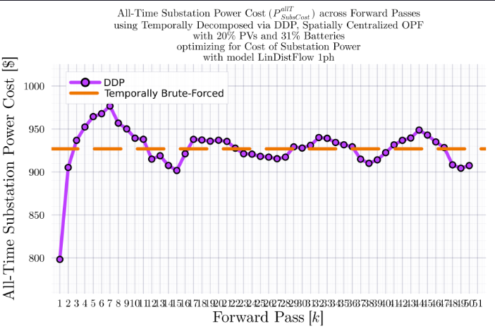
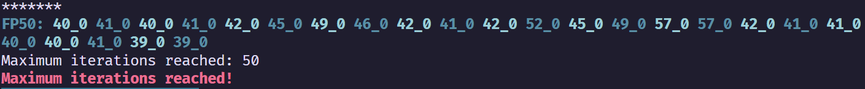
tENApp Trajectory vs #Forward Passes $[k]$: LinDistFlow Model Terminal SOC Constraint Relaxed
$$IEEE123A_{\left\{1ph\right\}}, T=24$$
BruteForced (BF)
$$tENApp$$
$γ=1$ (no update damping)
$$k_{Max}=50$$

Slide 21
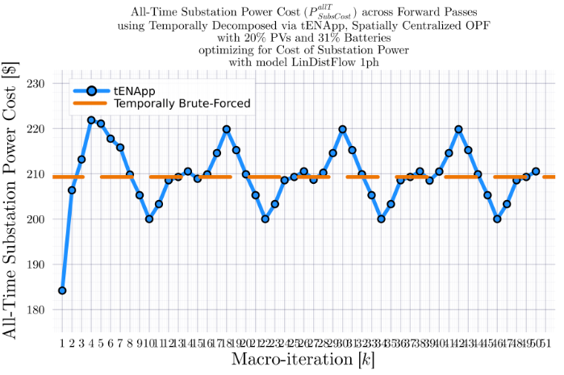
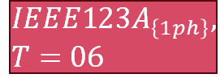

tENApp Trajectory vs #Forward Passes $[k]$: LinDistFlow Model Terminal SOC Constraint Relaxed
$$IEEE123A_{\left\{1ph\right\}}, T=06$$
BruteForced (BF)
$$tENApp$$
$γ=1$ (no update damping)
$$k_{Max}=50$$
$$α=1.00$$

Slide 22

tENApp Trajectory vs #Forward Passes $[k]$: LinDistFlow Model Terminal SOC Constraint Relaxed
$$IEEE123A_{\left\{1ph\right\}}, T=06$$
BruteForced (BF)
$$tENApp$$
$γ=1$ (no update damping)
$$k_{Max}=50$$
$$α=0.43$$

Slide 23

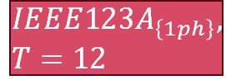

tENApp Trajectory vs #Forward Passes $[k]$: LinDistFlow Model Terminal SOC Constraint Relaxed
$$IEEE123A_{\left\{1ph\right\}}, T=12$$
BruteForced (BF)
$$tENApp$$
$γ=1$ (no update damping)
$$k_{Max}=100$$
$$α=0.43$$

Slide 24
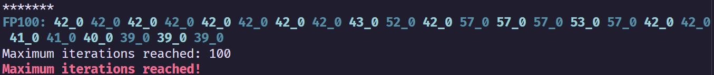

tENApp Trajectory vs #Forward Passes $[k]$: LinDistFlow Model Terminal SOC Constraint Relaxed
$$IEEE123A_{\left\{1ph\right\}}, T=24$$
BruteForced (BF)
$$tENApp$$
$γ=1$ (no update damping)
$$k_{Max}=100$$
$$α=3.00$$

Slide 25
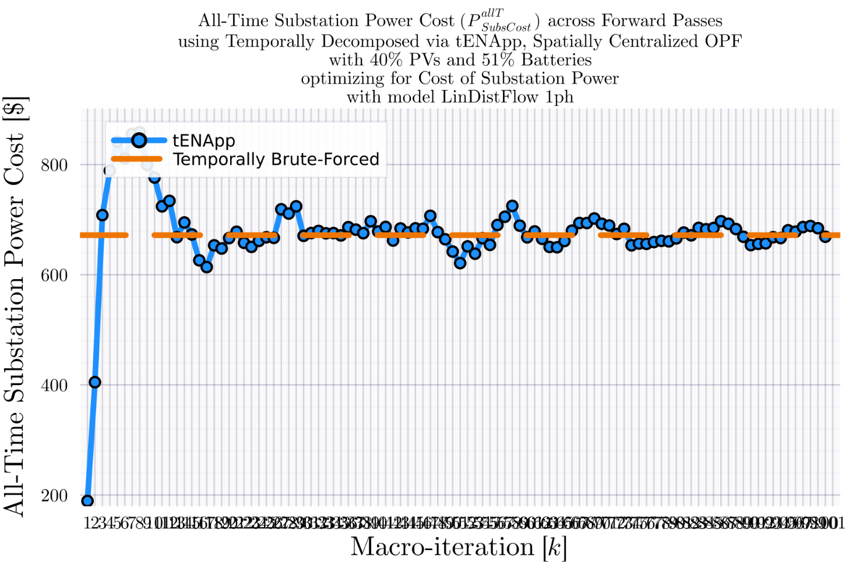
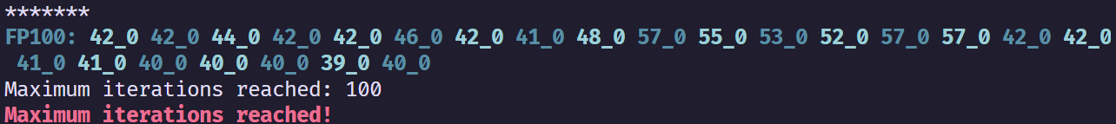
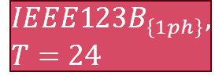
tENApp Trajectory vs #Forward Passes $[k]$: LinDistFlow Model Terminal SOC Constraint Relaxed
$$IEEE123B_{\left\{1ph\right\}}, T=24$$
BruteForced (BF)
$$tENApp$$
$γ=1$ (no update damping)
$$k_{Max}=100$$
$$α=3.00$$

Slide 26

tENApp Trajectory vs #Forward Passes $[k]$: LinDistFlow Model Terminal SOC Constraint Relaxed
$$IEEE123A_{\left\{1ph\right\}}, T=12$$
BruteForced (BF)
$$tENApp$$
$γ=1$ (no update damping)
$$k_{Max}=100$$
$$α=0.75$$

Slide 27
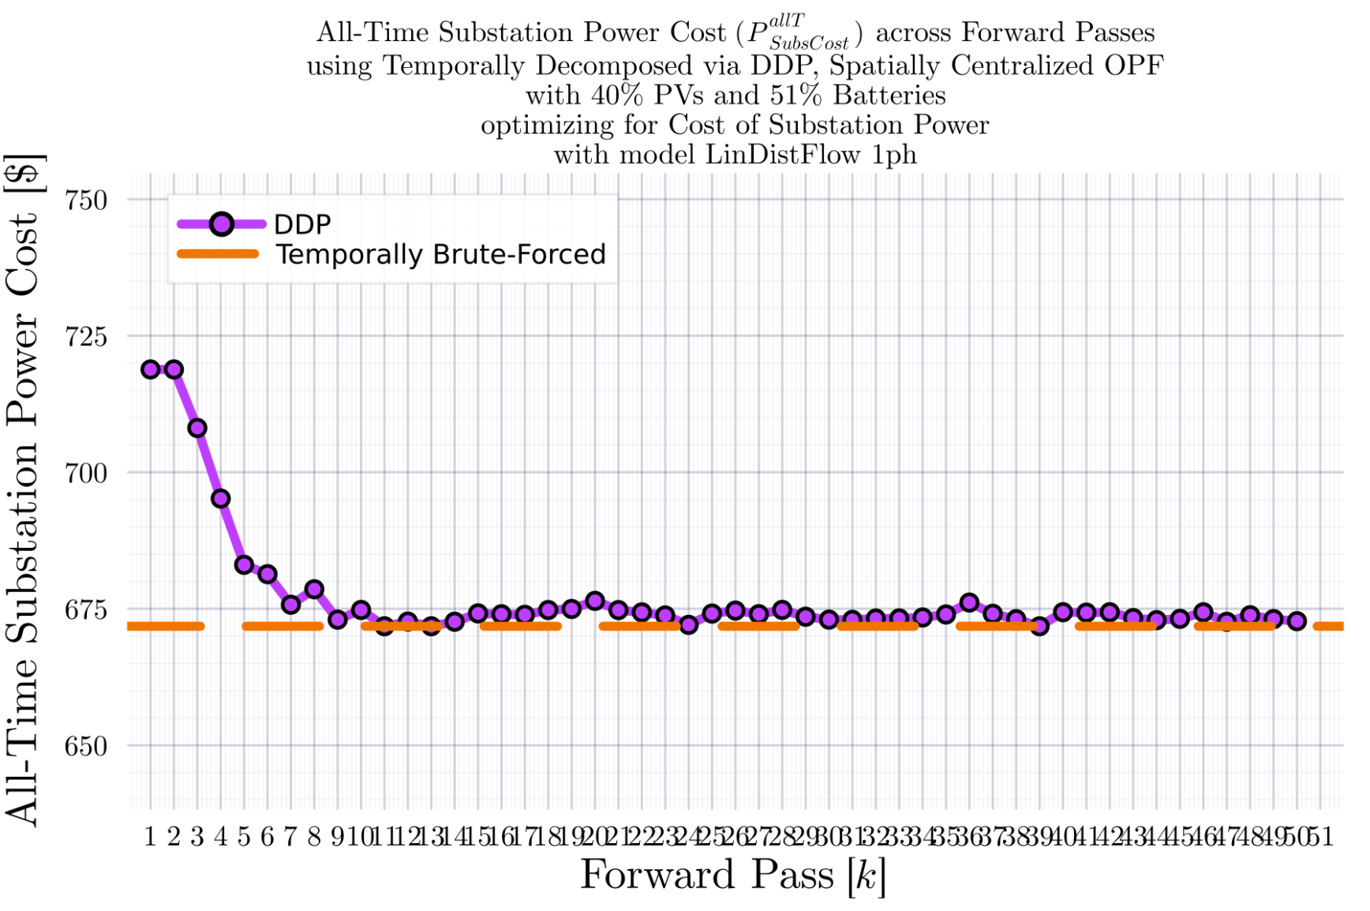

DDP Trajectory vs #Forward Passes $[k]$: LinDistFlow Model Terminal SOC Constraint Relaxed
$$IEEE123B_{\left\{1ph\right\}}, T=24$$
BruteForced (BF)
$$DDP$$
DDP didn’t converge in the given number of iterations..
$γ=1$ (no update damping)
$$k_{Max}=50$$

Slide 28
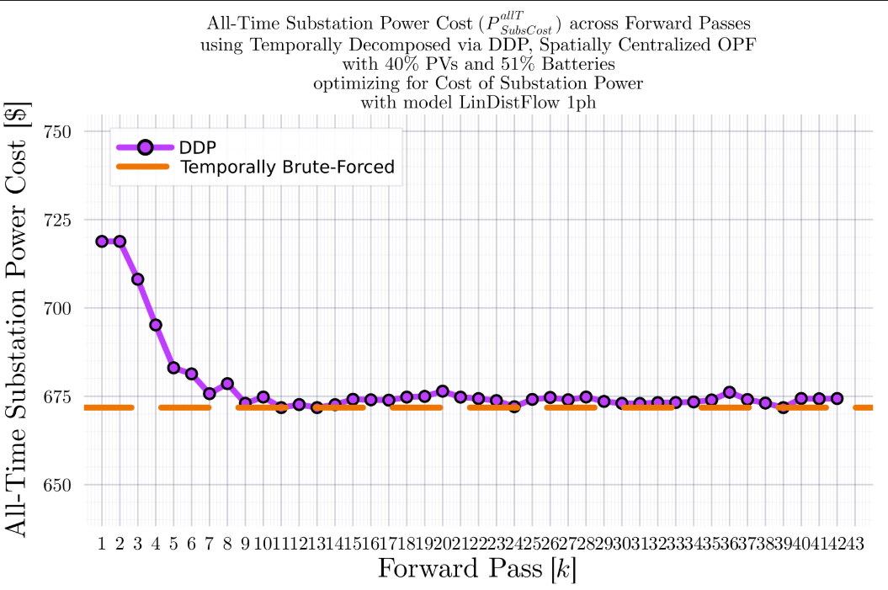
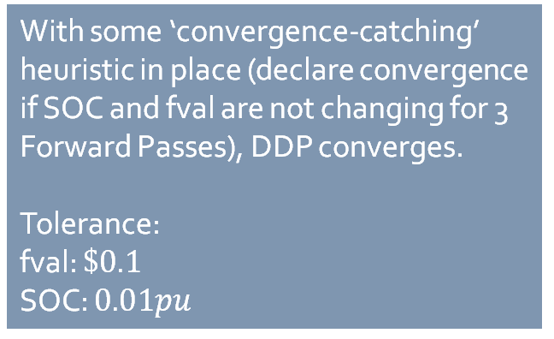
DDP Trajectory vs #Forward Passes $[k]$: LinDistFlow Model Terminal SOC Constraint Relaxed
$$IEEE123B_{\left\{1ph\right\}}, T=24$$
BruteForced (BF)
$$DDP$$
With some ‘convergence-catching’ heuristic in place (declare convergence if SOC and fval are not changing for 3 Forward Passes), DDP converges.
Tolerance:
fval: $\$0.1$
SOC: $0.01pu$
$γ=1$ (no update damping)
$$k_{Max}=50$$

Slide 29
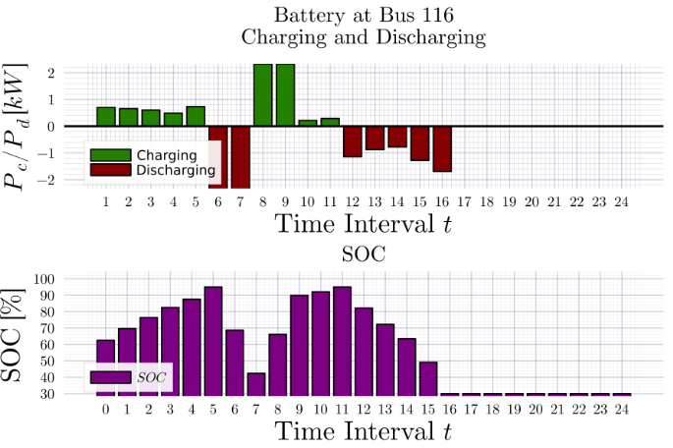
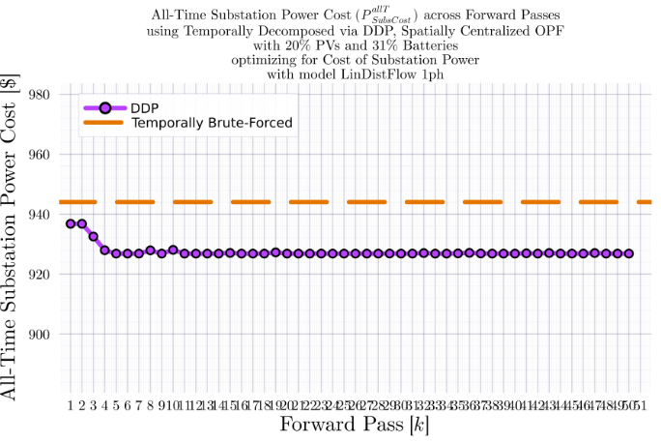
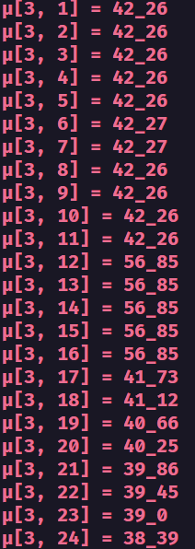
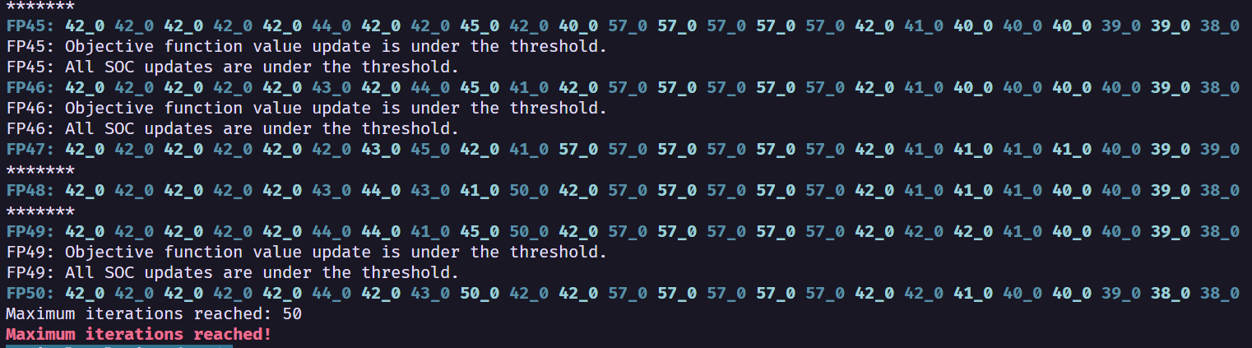
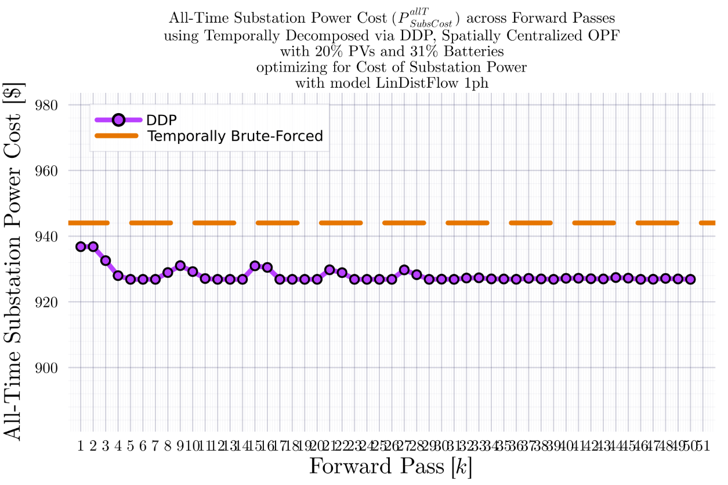
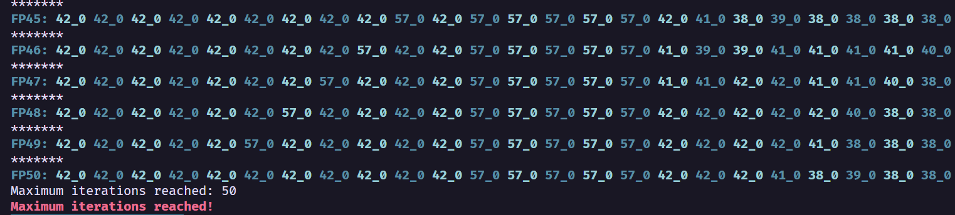
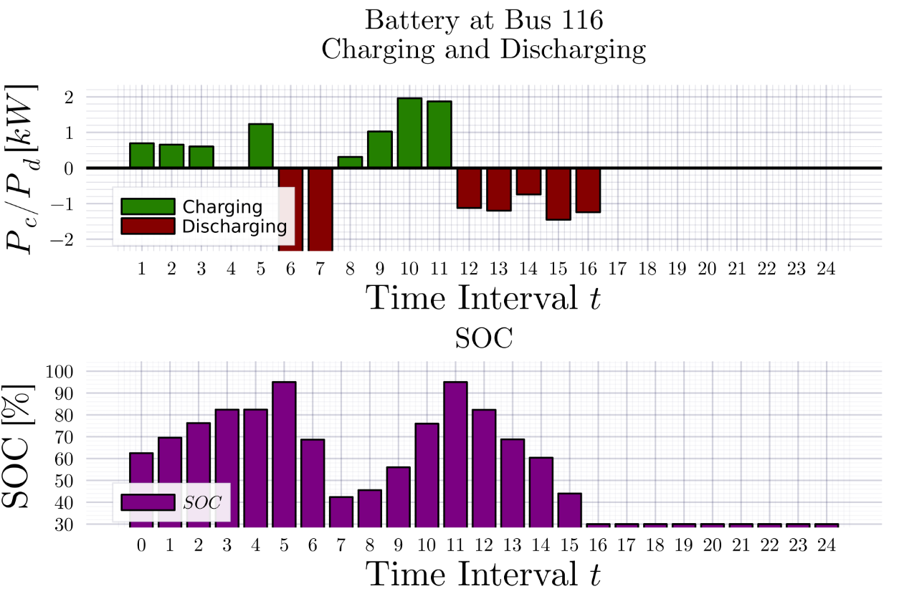
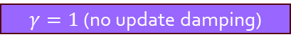

DDP Trajectory vs #Forward Passes $[k]$: LinDistFlow Model Terminal SOC Constraint Relaxed
$$IEEE123A_{\left\{1ph\right\}}, T=24$$
BruteForced (BF)
$$DDP$$
$γ=1$ (no update damping)
$γ=1$ (no update damping)
$$γ=0.5$$
$$γ=0.5$$
$$k_{Max}=25$$

Slide 30
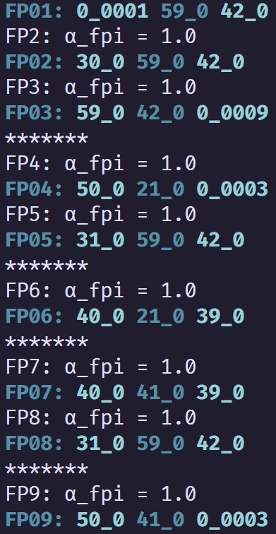
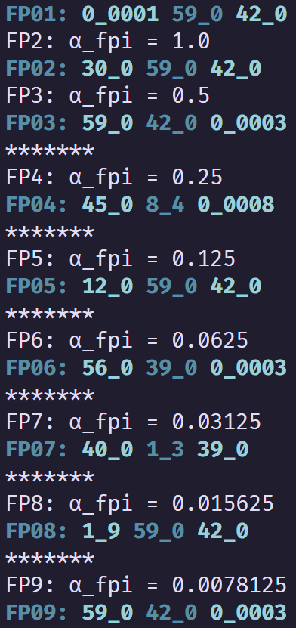
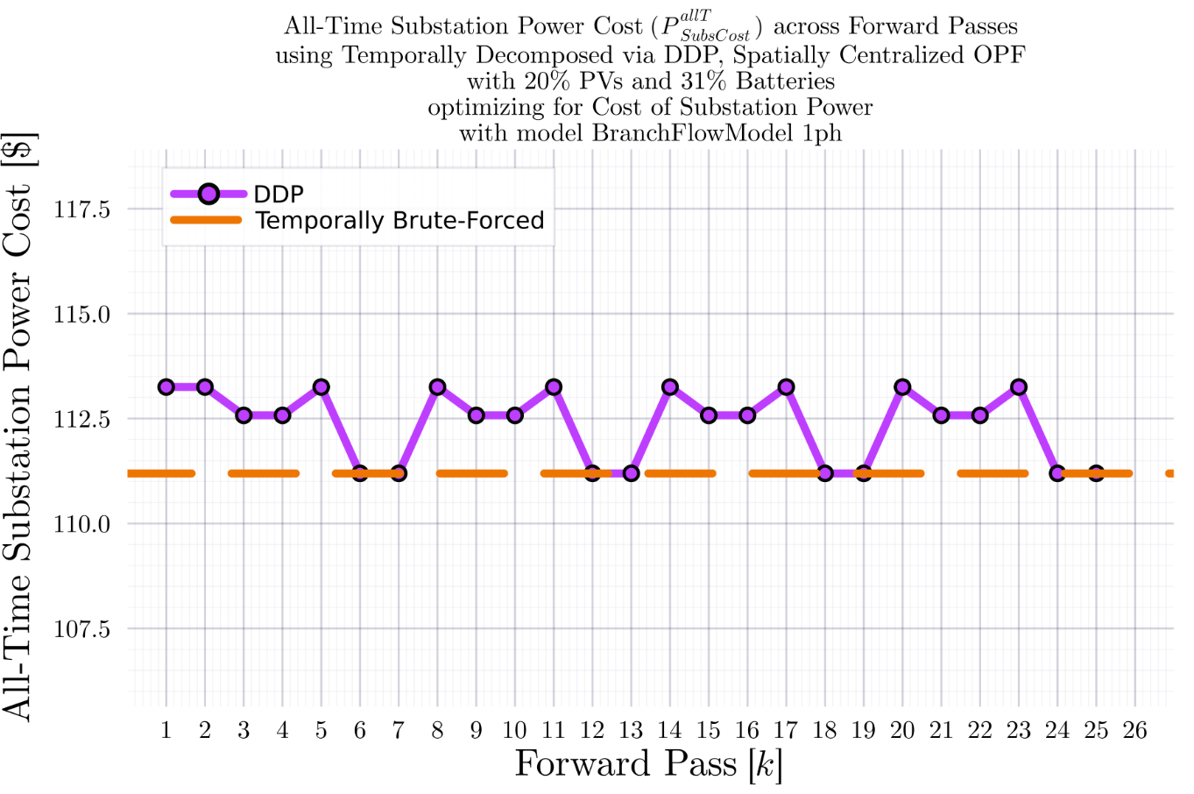
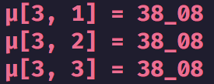





DDP Trajectory vs #Forward Passes $[k]$ Terminal SOC Constraint Relaxed
$$IEEE123A_{\left\{1ph\right\}}, T=3$$
BruteForced (BF)
$$DDP$$
$$FP\left(k\right):μ_{k}\left(t=1\right), μ_{k}\left(t=2\right), μ_{k}(t=3)$$
$$μ_{used}=\frac{μ^{k−1}+α∗μ^{k−2}}{1+α}$$
$$α^{k}=α_{0}∗γ^{k−2}$$
$$α_{0}=1.0$$
$γ=1$ (no update damping)
$$γ=0.5$$
$$k_{Max}=25$$
$γ=1$ (no update damping)
$$γ=0.5$$
Fluctuation ${\text{of} μ}_{k}^{T}$ value between $0$ and a ‘regular’ non-zero value

Slide 31








DDP Trajectory vs #Forward Passes $[k]$ Terminal SOC Constraint Relaxed
$$IEEE123A_{\left\{1ph\right\}}, T=6$$
BruteForced (BF)
$$DDP$$
$γ=1$ (no update damping)
$$γ=0.5$$
$γ=1$ (no update damping)
$$γ=0.5$$
$$k_{Max}=25$$

Slide 32





DDP Trajectory vs #Forward Passes $[k]$ Terminal SOC Constraint Relaxed
$$IEEE123A_{\left\{1ph\right\}}, T=24$$
BruteForced (BF)
$$DDP$$
$γ=1$ (no update damping)
$γ=1$ (no update damping)
$$γ=0.5$$
$$γ=0.5$$
$$k_{Max}=25$$

Slide 33



DDP Trajectory vs #Forward Passes $[k]$ Terminal SOC Constraint Relaxed
$$IEEE123A_{\left\{1ph\right\}}, T=96$$
BruteForced (BF)
$$DDP$$
$$k_{Max}=25$$

Slide 34










DDP Trajectory vs #Forward Passes $[k]$ Terminal SOC Constraint Relaxed
$$IEEE123B_{\left\{1ph\right\}}, T=96$$
BruteForced (BF)
$$DDP$$
$γ=1$ (no update damping)
$γ=1$ (no update damping)
$$k_{Max}=25$$

Slide 35








DDP Trajectory vs #Forward Passes $[k]$ Terminal SOC Constraint Relaxed
$$IEEE123B_{\left\{1ph\right\}}, T=24$$
BruteForced (BF)
$$DDP$$
$γ=1$ (no update damping)
$γ=1$ (no update damping)
$$γ=0.5$$
$$γ=0.5$$
$$k_{Max}=25$$

Slide 36




DDP Trajectory vs #Forward Passes $[k]$ Terminal SOC Constraint Relaxed
$$IEEE123B_{\left\{1ph\right\}}, T=24$$
BruteForced (BF)
$$DDP$$
$$k_{Max}=11$$

Slide 37




DDP Trajectory vs #Forward Passes $[k]$ Terminal SOC Constraint Relaxed
$$IEEE123B_{\left\{1ph\right\}}, T=24$$
$$DDP$$
$$k_{Max}=11$$

Slide 38




DDP Trajectory vs #Forward Passes $[k]$ Terminal SOC Constraint Relaxed
$$IEEE123B_{\left\{1ph\right\}}, T=24$$
BruteForced (BF)

Slide 39



DDP Trajectory vs #Forward Passes $[k]$ Terminal SOC Constraint Relaxed
$$IEEE123B_{\left\{1ph\right\}}, T=24$$
BruteForced (BF)
$$DDP$$
$$k_{Max}=7$$

Slide 40



DDP Trajectory vs #Forward Passes $[k]$ Terminal SOC Constraint Relaxed
$$IEEE123B_{\left\{1ph\right\}}, T=24$$
$$DDP$$
$$k_{Max}=11$$

Slide 41


DDP Trajectory vs #Forward Passes $[k]$ Terminal SOC Constraint Relaxed
$$IEEE123B_{\left\{1ph\right\}}, T=24$$
BruteForced (BF)
$$DDP$$
$$k_{Max}=25$$

Slide 42



DDP Trajectory vs #Forward Passes $[k]$ Terminal SOC Constraint Relaxed
$$IEEE123B_{\left\{1ph\right\}}, T=24$$
$$DDP$$
$$k_{Max}=25$$

Slide 43


IEEE 730 1ph Node System
34 12.66kV to 12.66kV branches (high impedance)
43 12.66kV to 0.24kV branches (low impedance)
$$k{V_{B}}_{Sys}=0.24$$
$$kV_{B_{Sec}}=0.24$$
$$kV_{B_{Pri}}=12.66$$
$$MV{A_{B}}_{Sys}=100$$
$$MVA_{B_{Xfm}}=0.07$$
$$Z_{B_{Sys}}=Z_{B_{Sec}}=0.000576$$
$$Z_{B_{Pri}}=1.602756$$
1
2
2
2
1
4
1
1
1
0
1
4
1
1
1
1
2
1
2
1
1
1
1
1
1
1
1
1
1
1
1
1
0
1
0
1

Slide 44


Comparison of BFM-NL-1ph and LinDistFlow-1ph Optimization Results
LinDistFlow Optimal Actions used in OpenDSS
BFM-NL
Optimal Actions used in OpenDSS

Slide 45


Comparison of BFM-NL-1ph and LinDistFlow-1ph Optimization Results
LinDistFlow Own Solutions
BFM-NL Own Solutions

Slide 46


Comparison of BFM-NL-1ph and LinDistFlow-1ph Optimization Results
LinDistFlow
BFM-NL

Slide 47








DDP Trajectory vs #Forward Passes $[k]$ Terminal SOC Constraint Relaxed
$$ADS{10}_{1ph}, T=96$$
BruteForced (BF)
$$DDP$$
Looks ‘successful’
$$k_{Max}=33$$

Slide 48







DDP Trajectory vs #Forward Passes $[k]$ Terminal SOC Constraint Relaxed
$$IEEE{123}_{1ph}, T=96$$
BruteForced (BF)
$$DDP$$
Looks ‘successful’
$$k_{Max}=33$$

Slide 49







DDP Trajectory vs #Forward Passes $[k]$ Terminal SOC Constraint Relaxed
$$ADS{10}_{1ph}, T=24$$
BruteForced (BF)
$$DDP$$
Looks ‘successful’
$$k_{Max}=33$$

Slide 50






DDP Trajectory vs #Forward Passes $[k]$ Terminal SOC Constraint Relaxed
$$IEEE{123}_{1ph}, T=24$$
BruteForced (BF)
$$DDP$$
Looks ‘successful’
$$k_{Max}=33$$

Slide 51







DDP Trajectory vs #Forward Passes $[k]$ Terminal SOC Constraint Relaxed
$$ADS{10}_{1ph}, T=12$$
BruteForced (BF)
$$DDP$$
Will NOT converge
$$k_{Max}=33$$
Even if not converging, it at least does ‘hit’ the optimal value periodically.

Slide 52



DDP Trajectory vs #Forward Passes $[k]$ Terminal SOC Constraint Relaxed
$$ADS{10}_{1ph}, T=12$$
BruteForced (BF)
$$DDP$$
Will NOT converge
$$k_{Max}=55$$
Even if not converging, it at least does ‘hit’ the optimal value periodically.

Slide 53




DDP Trajectory vs #Forward Passes $[k]$ Terminal SOC Constraint Relaxed
$$ADS{10}_{1ph}, T=12$$
BruteForced (BF)
$$DDP$$
Will NOT converge
$$k_{Max}=77$$
Even if not converging, it at least does ‘hit’ the optimal value periodically.

Slide 54




DDP Trajectory vs #Forward Passes $[k]$ Terminal SOC Constraint Relaxed
$$ADS{10}_{1ph}, T=12$$
BruteForced (BF)
$$DDP$$
Will NOT converge
$$k_{Max}=222$$
Even if not converging, it at least does ‘hit’ the optimal value periodically.

Slide 55







DDP Trajectory vs #Forward Passes $[k]$ Terminal SOC Constraint Relaxed
$$IEEE{123}_{1ph}, T=12$$
BruteForced (BF)
$$DDP$$
Will NOT converge
$$k_{Max}=33$$
Even if not converging, it at least does ‘hit’ the optimal value periodically.

